Slide 1
Introduction to Data Science
John P Dickerson
Lecture #12 – 10/08/2020
Lecture #13 – 10/13/2020
CMSC320
Tuesdays & Thursdays
5:00pm – 6:15pm (… or anytime on the Internet)

Slide 2
Today’s Lecture
Data collection
Data processing
Exploratory analysis
&
Data viz
Analysis, hypothesis testing, & ML
Insight & Policy Decision
(Mainly.)

Slide 3
Today’s Lecture
Missing Data …
What is it?
Simple methods for imputation
… with a tiny taste of Stats/ML lecturers to come.
Thanks to John Atwood and Wenjiang Fu

Slide 4
Missing Data
Missing data is information that we want to know, but don’t
It can come in many forms, e.g.:
People not answering questions on surveys
Inaccurate recordings of the height of plants that need to be discarded
Canceled runs in a driving experiment due to rain
Could also consider missing columns (no collection at all) to be missing data …
[JA]

Slide 5
Key Question
Why is the data missing?
What mechanism is it that contributes to, or is associated with, the probability of a data point being absent?
Can it be explained by our observed data or not?
The answers drastically affect what we can ultimately do to compensate for the missing-ness
[JA]

Slide 6
Complete Case Analysis
Delete all tuples with any missing values at all, so you are left only with observations with all variables observed
Default behavior for libraries for analysis (e.g., regression)
We’ll talk about this much more during the Stats/ML lectures
This is the simplest way to handle missing data. In some cases, will work fine; in others, ?????????????:
Loss of sample will lead to variance larger than reflected by the size of your data
May bias your sample
# Clean out rows with nil values
df = df.dropna()
[JA]

Slide 7
Example
Dataset: Body fat percentage in men, and the circumference of various body parts [Penrose et al., 1985]
Question: Does the circumference of certain body parts predict body fat percentage?
Given complete data, how would you answer this ?????????
One way to answer is regression analysis:
One or more independent variables ("predictors”)
One dependent variables (“outcome”)
What is the relationship between the predictors and the outcome?
What is the conditional expectation of the dependent variable given fixed values for the dependent variables?

Slide 8
Linear regression
Assumption: relationship between variables is linear:
(We’ll relax linearity, study in more depth later.)
Population Y-Intercept
Population Slope
Random Error
Y
=
β
+
β
X
+
ε
i
0
1
i
i
Dependent Variable (e.g., ????????)
Independent Variable(s) (e.g., ?????????)
[WF]

Slide 9
Population & Sample Regression Models
Population
☺
☺
☺
☺
☺
[WF]
Notes:
31

Slide 10
Population & Sample Regression Models
Population
Unknown Relationship
☺
☺
☺
☺
☺
[WF]
Notes:
32

Slide 11
Population & Sample Regression Models
Population
Random Sample
Unknown Relationship
☺
☺
☺
☺
☺
☺
☺
[WF]
Notes:
33

Slide 12
Population & Sample Regression Models
Population
Random Sample
Unknown Relationship
☺
☺
☺
☺
☺
☺
☺
[WF]
Notes:
34

Slide 13
Linear Regression
Observedvalue
ε_{i} = Random error
Observed value
[WF]
Notes:
35

Slide 14
Sample Linear Regression Model
ε_{i} = Random error
^
Unsampled observation
Observed value
[WF]
Notes:
36

Slide 15
Estimating Parameters: Least Squares Method
?
Notes:
40

Slide 16
Scatter plot
Plot all (X_{i}, Y_{i}) pairs, and plot your learned model
If you squint, suggests how well the model fits the data
Y
60
40
20
0
X
0
20
40
60
[WF]

Slide 17
QUestion
How would you draw a line through the points?
How do you determine which line “fits the best” …? ?????????
Y
60
40
20
0
X
0
20
40
60
[WF]
Notes:
42

Slide 18
Question
How would you draw a line through the points?
How do you determine which line “fits the best” ?????????
Slope changed
Y
60
40
20
0
X
0
20
40
60
Intercept unchanged
[WF]
Notes:
43

Slide 19
Question
How would you draw a line through the points?
How do you determine which line “fits the best” ?????????
Slope unchanged
Y
60
40
20
0
X
0
20
40
60
Intercept changed
[WF]
Notes:
44

Slide 20
Question
How would you draw a line through the points?
How do you determine which line “fits the best” ?????????
Slope changed
Y
60
40
20
0
X
0
20
40
60
Intercept changed
[WF]
Notes:
45

Slide 21
Least Squares
Best fit: difference between the true Y-values and the estimated Y-values is minimized:
Positive errors offset negative errors …
… square the error!
Least squares minimizes the sum of the squared errors
Why squared? We’ll cover this in more depth in a few weeks.
Until then: http://www.benkuhn.net/squared
[WF]
Notes:
51

Slide 22
Least Squares, Graphically
[WF]
Notes:
52

Slide 23
Interpretation of Coefficients
^
Slope (β₁):
Estimated Y changes by β₁ for each unit increase in X
If β₁ = 2, then Y Is expected to increase by 2 for each 1 unit increase in X
Y-Intercept (β₀)
Average value of Y when X = 0
If β₀ = 4, then average Y is expected to be 4 when X Is 0
^
^
^
In-depth analysis of less naïve approaches to come!
[WF]

Slide 24
Now, Back to Missing Data …

Slide 25
Example
Question: Does the circumference of certain body parts predict BF%?
Assumption: BF% is a linear function of measurements of various body parts and other features …
Analysis: Results from a regression model with BF% …
Predictor | Estimate | S.E. | p-value
Age | 0.0626 | 0.0313 | 0.0463
Neck | -0.4728 | 0.2294 | 0.0403
Forearm | 0.45315 | 0.1979 | 0.0229
Wrist | -1.6181 | 0.5323 | 0.0026
(Interpretation ???????????)
[JA]
Notes:
Standard error – estimate of the standard deviation, will talk about this more later …
The p-value is the probability of obtaining a result equal to or "more extreme" than what was actually observed, when the null hyp is actually true – we’ll talk about this more …

Slide 26
What If data were missing?
In this case, the dataset is complete:
But what if 5 percent of the participants had missing values? 10 percent? 20 percent?
What if we performed complete case analysis and removed those who had missing values?
First let’s examine the effect if we do this if when the data is missing completely at random (MCAR)
Removed cases at random, reran analysis, stored the p-values
p-value: probability of getting at least as extreme a result as what we observed given that there is no relationship
Repeat 1000 times, plot p-values …
[JA]

Slide 27
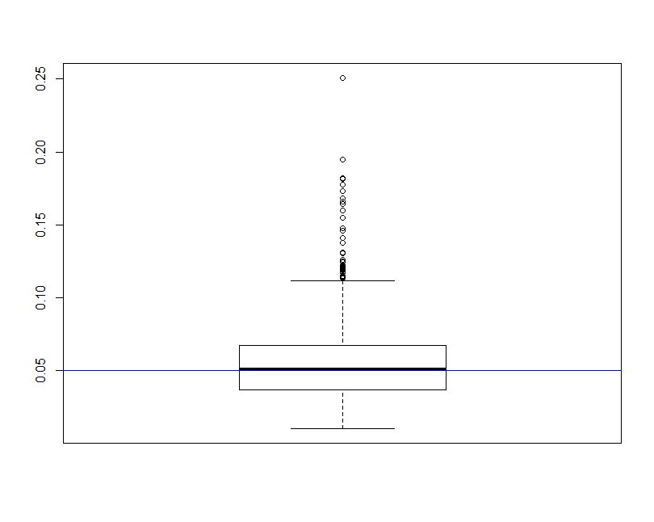
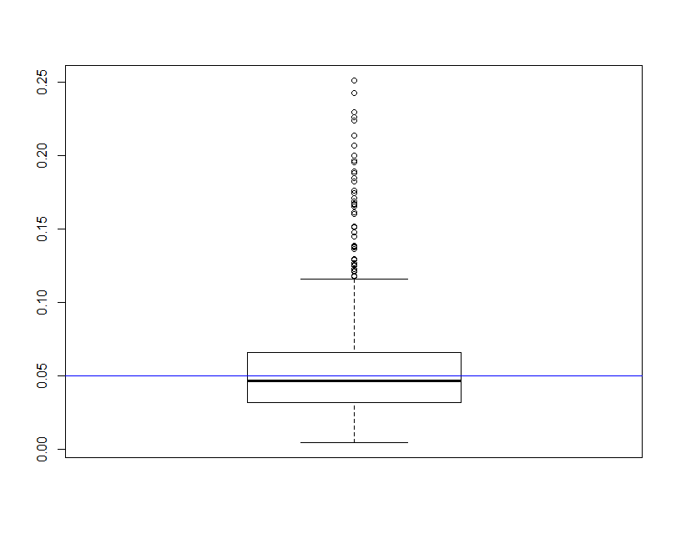
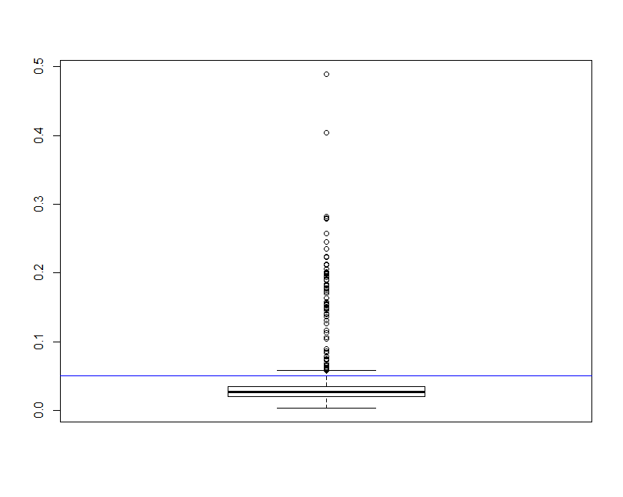
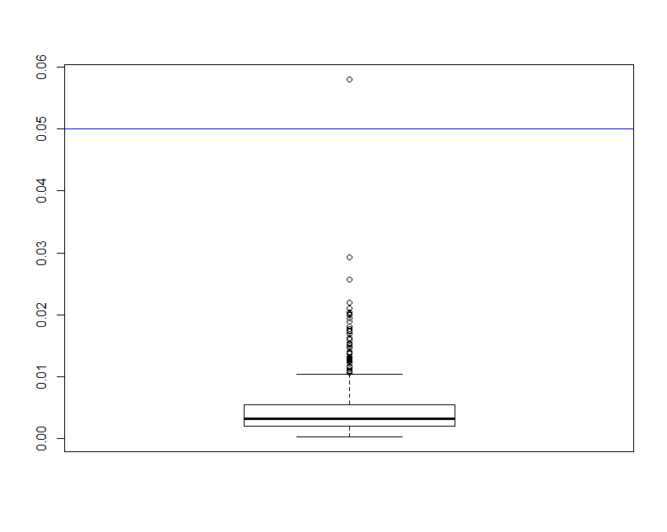
~5% Deleted (N=13)
p-value
Age
Neck
Forearm
Wrist
[JA]

Slide 28
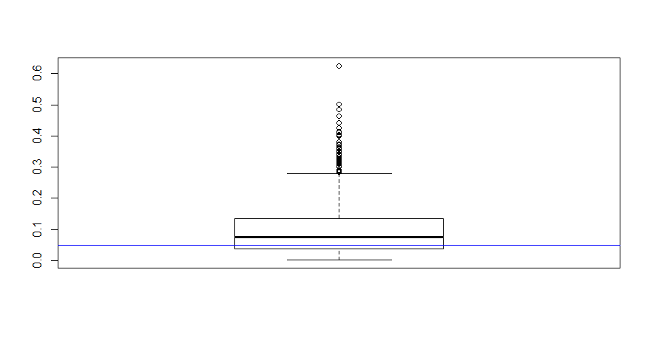
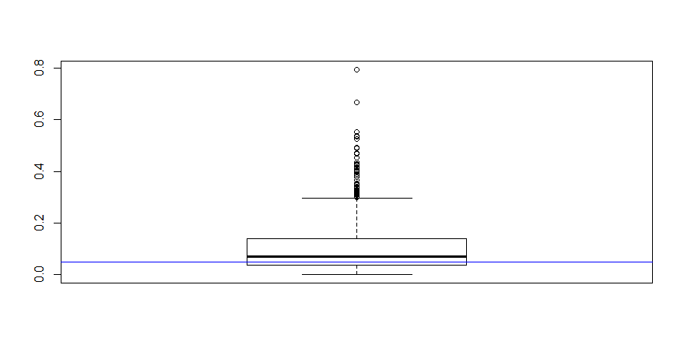
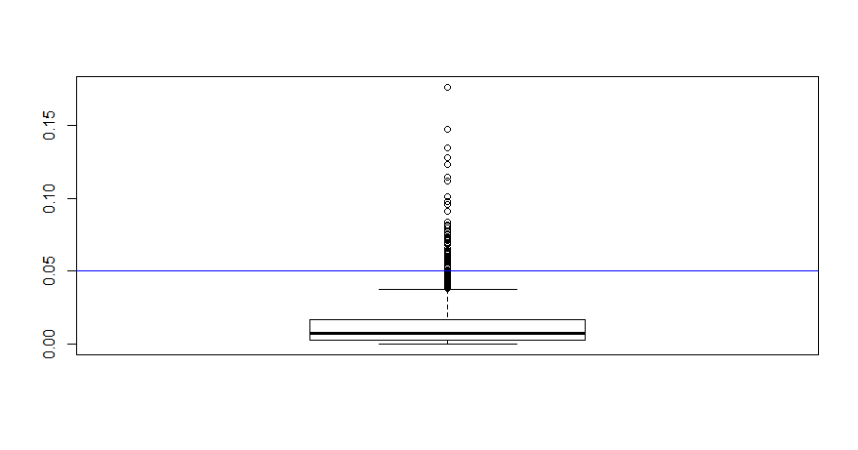
~20% Deleted (N=50)
p-value
Age
Forearm
Wrist
Neck
[JA]

Slide 29
Conclusions seem to change …
Age/Neck: fail to reject the null hypothesis usually?
vs
Age (5%)
Neck (5%)
Age (20%)
Neck (20%)
Still reject Forearm/Wrist most of the time
This is assuming the missing subjects’ distribution does not differ from the non-missing. This would cause bias …
[JA]

Slide 30
Types Of Missing-ness
Missing Completely at Random (MCAR)
Missing at Random (MAR)
Missing Not at Random (MNAR)
[JA]

Slide 31

What Distinguishes Each Type of missing-ness?
Suppose you’re loitering outside of Iribe one day …
Students just received their mid-semester grades
You start asking passing students their CMSC131 grades
You don’t force them to tell you or anything
You also write down their height (>6ft or not) and hair color
[JA]

Slide 32
Your Sample
Hair Color | > 6ft | Grade
Red | Y | A
Brown | N | A
Black | N | B
Black | Y | A
Brown | Y
Brown | Y
Brown | N
Black | Y | B
Black | Y | B
Brown | N | A
Black | N
Brown | N | C
Red | Y
Red | N | A
Brown | Y | A
Black | Y | A
Summary:
7 students received As
3 students received Bs
1 student received a C
Nobody is failing!
But 5 students did not reveal their grade …
[JA]

Slide 33
What influences a data point’s Presence?
Same dataset, but the values are replaced with a “0” if the data point is observed and “1” if it is not
Question: for any one of these data points, what is the probability that the point is equal to “1” …?
What type of missing-ness do the grades exhibit?
Hair Color | >6ft | Grade
0 | 0 | 0
0 | 0 | 0
0 | 0 | 0
0 | 0 | 0
0 | 0 | 1
0 | 0 | 1
0 | 0 | 1
0 | 0 | 0
0 | 0 | 0
0 | 0 | 0
0 | 0 | 1
0 | 0 | 0
0 | 0 | 1
0 | 0 | 0
0 | 0 | 0
0 | 0 | 0
[JA]

Slide 34
MCAR: Missing Completely at Random
If this probability is not dependent on any of the data, observed or unobserved, then the data is Missing Completely at Random (MCAR)
Suppose that X is the observed data and Y is the unobserved data. Call our “missing matrix” R
Then, if the data are MCAR, P(R|X,Y) = ??????????
P(R|X,Y) = P(R)
Probability of those rows missing is independent of anything.
[JA]

Slide 35
Totally Realistic MCAR Example
You are running an experiment on plants grown in pots, when suddenly you have a nervous breakdown and smash some of the pots
You will probably not choose the plants to smash in a well-defined pattern, such as height age, etc.
Hence, the missing values generated from your act of madness will likely fall into the MCAR category
[JA]

Slide 36
Applicability of MCAR
A completely random mechanism for generating missing-ness in your data set just isn’t very realistic
Usually, missing data is missing for a reason:
Maybe older people are less likely to answer web-delivered questions on surveys
In longitudinal studies people may die before they have completed the entire study
Companies may be reluctant to reveal financial information

Slide 37
MAR: Missing at Random
Missing at Random (MAR): probability of missing data is dependent on the observed data but not the unobserved data
Suppose that X is the observed data and Y is the unobserved data. Call our “missing matrix” R
Then, if the data are MAR, P(R|X,Y) = ??????????
P(R|X,Y) = P(R|X)
Not exactly random (in the vernacular sense).
There is a probabilistic mechanism that is associated with whether the data is missing
Mechanism takes the observed data as input

Slide 38
ExampleS?
?

Slide 39
MAR: Key Point
We can model that latent mechanism and compensate for it
Imputation: replacing missing data with substituted values
Models today will assume MAR
Example: if age is known, you can model missing-ness as a function of age
Whether or not missing data is MAR or the next type, Missing Not at Random (MNAR), is not* testable.
Requires you to “understand” your data
*unless you can get the missing data (e.g., post-study phone calls)

Slide 40
MNAR: Missing Not at Random
MNAR: missing-ness has something to do with the missing data itself
Examples: ??????????
Do you binge drink? Do you have a trust fund? Do you use illegal drugs? What is your sexuality? Are you depressed?
Said to be “non-ignorable”:
Missing data mechanism must be considered as you deal with the missing data
Must include model for why the data are missing, and best guesses as to what the data might be

Slide 41
Back to Iribe …
Hair Color | > 6ft | Grade
Red | Y | A
Brown | N | A
Black | N | B
Black | Y | A
Brown | Y
Brown | Y
Brown | N
Black | Y | B
Black | Y | B
Brown | N | A
Black | N
Brown | N | C
Red | Y
Red | N | A
Brown | Y | A
Black | Y | A
Is the the missing data:
MCAR;
MAR; or
MNAR?
???????????

Slide 42
Add a variable
Bring in the GPA:
Does this change anything?
Hair Color | GPA | > 6ft | Grade
Red | 3.4 | Y | A
Brown | 3.6 | N | A
Black | 3.7 | N | B
Black | 3.9 | Y | A
Brown | 2.5 | Y
Brown | 3.2 | Y
Brown | 3.0 | N
Black | 2.9 | Y | B
Black | 3.3 | Y | B
Brown | 4.0 | N | A
Black | 3.65 | N
Brown | 3.4 | N | C
Red | 2.2 | Y
Red | 3.8 | N | A
Brown | 3.8 | Y | A
Black | 3.67 | Y | A

Slide 43
Handling Missing Data …

Slide 44
Single Imputation
Mean imputation: imputing the average from observed cases for all missing values of a variable
Hot-deck imputation: imputing a value from another subject, or “donor,” that is most like the subject in terms of observed variables
Last observation carried forward (LOCF): order the dataset somehow and then fill in a missing value with its neighbor
Cold-deck imputation: bring in other datasets
Old and busted:
All fundamentally impose too much precision.
Have uncertainty over what unobserved values actually are
Developed before cheap computation

Slide 45
Multiple Imputation
Developed to deal with noise during imputation
Impute once → treats imputed value as observed
We have uncertainty over what the observed value would have been
Multiple imputation: generate several random values for each missing data point during imputation

Slide 46
Imputation Process
s₁
a₁
Incomplete data
s₂
a₂
Pooled results
s_{N}
a_{N}
Impute N times
Analysis performed on each imputed set

Slide 47
Tiny example
X | Y
32 | 2
43 | ?
56 | 6
25 | ?
84 | 5
Independent variable: X
Dependent variable: Y
We assume Y has a linear relationship with X

Slide 48
Let’s Impute Some Data!
Use a predictive distribution of the missing values:
Given the observed values, make random draws of the observed values and fill them in.
Do this N times and make N imputed datasets
X | Y
32 | 2
43 | 5.5
56 | 6
25 | 8
84 | 5
X | Y
32 | 2
43 | 7.2
56 | 6
25 | 1.1
84 | 5
For very large values of N=2 …

Slide 49
Inference with Multiple Imputation
Now that we have our imputed data sets, how do we make use of them? ???????????
Analyze each of the separately
X | Y
32 | 2
43 | 5.5
56 | 6
25 | 8
84 | 5
X | Y
32 | 2
43 | 7.2
56 | 6
25 | 1.1
84 | 5
Slope | -0.8245
Standard error | 6.1845
Slope | 4.932
Standard error | 4.287
Y
=
β
+
β
X
+
ε
Y
=
β
+
β
X
+
ε
i
0
1
i
i
i
0
1
i
i

Slide 50
Pooling analyses
Pooled slope estimate is the average of the N imputed estimates
Our example, β_{1p} = $\frac{β11+β12}{2}$ = (4.932-.8245) x 0.5 = 2.0538
The pooled slope variance is given by
$s= \frac{\sum{Zi}}{m}+(1+ \frac{1}{m}$) x $\frac{1}{m−1}∗\sum{(β1i }−$ β_{1p} )²
Where Z_{i} is the standard error of the imputed slopes
Our example: (4.287 + 6.1845)/2 + (3/2)*(16.569) = 30.08925
Standard error: take the square root, and we get 5.485
Notes:
For those following from home:
Variance: roughly how much a set of numbers are “spread around” their mean
Standard deviation: similar to variance (square root of variance) – same units as main data
Standard error (of the sample mean): how far the sample mean is from the population mean

Slide 51
Predicting the missing data given the observed data
Given events A, B; and P(A) > 0 …
Bayes’ Theorem:
$$P\left(B | A\right)=\frac{P(A|B)∗P(B)}{P(A)}$$
In our case:
$$P\left(H | E\right)=\frac{P(E|H)∗P(H)}{P(E)}$$
Probability of seeing evidence given the hypothesis
Prior probability of hypotheses
Posterior probability of the hypothesis given the evidence
Prior over the evidence

Slide 52
Bayesian Imputation
Establish a prior distribution:
Some distribution of parameters of interest θ before considering the data, P(θ)
We want to estimate θ
Given θ, can establish a distribution P(X_{obs}|θ)
Use Bayes Theorem to establish P(θ|X_{obs}) …
Make random draws for θ
Use these draws to make predictions of Y_{miss}

Slide 53
How big should N Be?
Number of imputations N depends on:
Size of dataset
Amount of missing data in the dataset
Some previous research indicated that a small N is sufficient for efficiency of the estimates, based on:
(1 + $\frac{λ}{N}$)-1
N is the number of imputations and λ is the fraction of missing information for the term being estimated [Schaffer 1999]
More recent research claims that a good N is actually higher in order to achieve higher power [Graham et al. 2007]

Slide 54
More advanced methods
Interested? Further reading:
Regression-based MI methods
Multiple Imputation Chained Equations (MICE) or Fully Conditional Specification (FCS)
Readable summary from JHU School of Public Health: https://www.ncbi.nlm.nih.gov/pmc/articles/PMC3074241/
Markov Chain Monte Carlo (MCMC)
We’ll cover this a bit, but also check out CMSC422!

Slide 55
Rest of Today’s Lecture
Data collection
Data processing
Exploratory analysis
&
Data viz
Analysis, hypothesis testing, & ML
Insight & Policy Decision
Continue with the general topic of data wrangling and cleaning & EDA intersection
Many slides from Amol Deshpande (UMD)

Slide 56
Overview
Goal: get data into a structured form suitable for analysis
Variously called: data preparation, data munging, data curation
Also often called ETL (Extract-Transform-Load) process
Often the step where majority of time (80-90%) is spent
Key steps:
Scraping: extracting information from sources, e.g., webpages, spreadsheets
Data transformation: to get it into the right structure
Data integration: combine information from multiple sources
Information extraction: extracting structured information from unstructured/text sources
Data cleaning: remove inconsistencies/errors

Slide 57
Overview
Goal: get data into a structured form suitable for analysis
Variously called: data preparation, data munging, data curation
Also often called ETL (Extract-Transform-Load) process
Often the step where majority of time (80-90%) is spent
Key steps:
Scraping: extracting information from sources, e.g., webpages, spreadsheets
Data transformation: to get it into the right structure
Information extraction: extracting structured information from unstructured/text sources
Data integration: combine information from multiple sources
Data cleaning: remove inconsistencies/errors
Already covered
In a few
classes

Slide 58
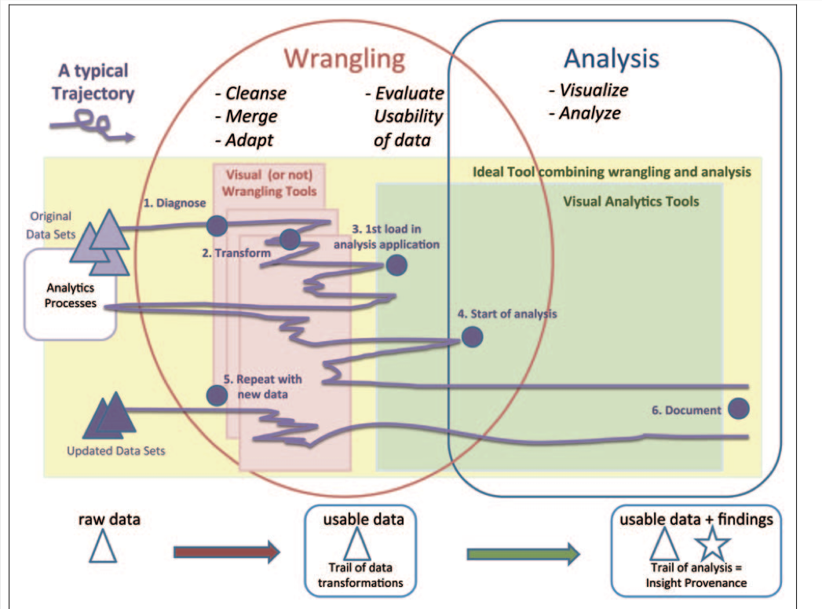
Overview

Slide 59
Overview
Many of the problems are not easy to formalize, and have seen little work
E.g., Cleaning
Others aspects of integration, e.g., schema mapping, have been studied in depth
A mish-mash of tools typically used
Visual (e.g., Trifacta), or not (UNIX grep/sed/awk, Pandas)
Ad hoc programs for cleaning data, depending on the exact type of errors
Different types of transformation tools
Visualization and exploratory data analysis to understand and remove outliers/noise
Several tools for setting up the actual pipelines, assuming the individual steps are setup (e.g., Talend, AWS Glue)

Slide 60
Outline
Data Integration
Data Quality Issues
Data Cleaning
Entity Resolution

Slide 61
Outline
Data Integration
Data Quality Issues
Data Cleaning
Entity Resolution

Slide 62
Data Integration
Linkage
Queries
Querying integrated information sources (e.g. queries to views, execution of web-based queries, …)
Data mining & analyzing integrated information (e.g., collaborative filtering/classification learning using extracted data, …)
Discovering information sources (e.g. deep web modeling, schema learning, …)
Gathering data (e.g., wrapper learning & information extraction, federated search, …)
Cleaning data (e.g., de-duping and linking records) to form a single [virtual] database

Slide 63
Data Integration
Goal: Combine data residing in different sources and provide users with a unified view of these data for querying or analysis
Each data source has its own schema called local schemas (much work assumes relational schemas, but some work on XML as well)
The unified schema is often called mediated schema or global schema
Two different setups:
Bring the data together into a single repository (often called data warehousing)
Keep the data where it is, and send queries back and forth

Slide 64
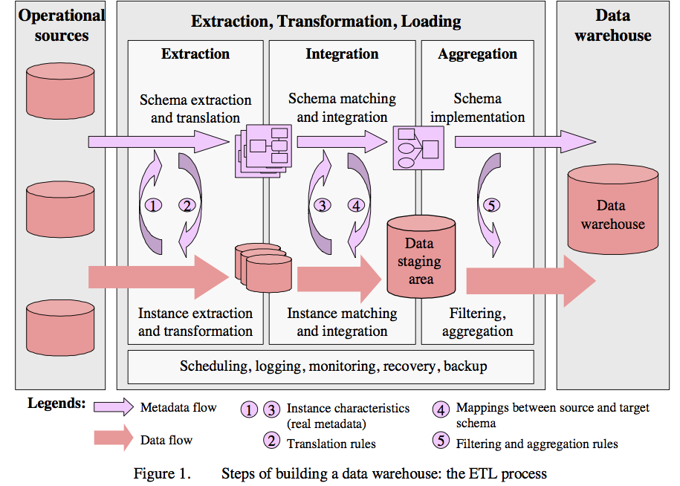
1. Data Warehousing
From Data Cleaning: Problems and Current Approaches
Many of the problems are not easy to formalize, and have seen little work
E.g., Cleaning
Others aspects of integration, e.g., schema mapping, have been studied in depth
Typical workflow
From Data Cleaning: Problems and Current Approaches
Somewhat old: data is mostly coming from structured sources
For a data scientist, the data scraping is equally important

Slide 65
2. In-place integration
Query Q
Mediated Schema
Q’
Q’
Q’
Q’
Q’
Source
Source
Source
Source
Source

Slide 66
Data Integration
Two different setups:
Bring the data together into a single repository (often called data warehousing)
Relatively easier problem - only need one-way-mappings
Query performance predictable and under your control
Keep the data where it is, and send queries back and forth
Need two-way mappings -- a query on the mediated schema needs to be translated into queries over data source schemas
Not as efficient and clean as data warehousing, but a better fit for dynamic data
Or when data warehousing is not feasible

Slide 67
Data Integration: Key Challenges
Data extraction, reconciliation, and cleaning
Get the data from each source in a structured form
Often need to use wrappers to extract data from web sources
May need to define a schema
Schema alignment and mapping
Decide on the best mediated schema
Figure out mappings and matchings between the local schemas and the global schema
Answer queries over the global schema
In the second scenario, need to figure out how to map a query on global schema onto queries over local schemas
Also need to decide which sources contain relevant data
Limitations in mechanisms for accessing sources
Many sources have limits on how you can access them
Limits on the number of queries you can issues (say 100 per min)
Limits on the types of queries (e.g., must enter a zipcode to get information from a web source)

Slide 68
Schema Matching or Alignment
Flashbacks to Project 1 …
Goal: Identify corresponding elements in two schemas
As a first step toward constructing a global schema
Schema heterogeneity is a key roadblock
Different data sources speak their own schema
Hotel, Restaurant,
AdventureSports, HistoricalSites
Data Source
Consumer
Hotel, Gaststätte
Brauerei, Kathedrale
Data Source
Mediator
Data Source
Lodges, Restaurants
Beaches, Volcanoes

Slide 69
Schema Matching or Alignment
Books
Title
ISBN
Price
DiscountPrice
Edition
Authors
ISBN
FirstName
LastName
BooksAndMusic
Title
Author
Publisher
ItemID
ItemType
SuggestedPrice
Categories
Keywords
BookCategories
ISBN
Category
CDCategories
ASIN
Category
CDs
Album
ASIN
Price
DiscountPrice
Studio
Inventory
Database A
Artists
ASIN
ArtistName
GroupName
Inventory Database B

Slide 70
summary
Data integration continues to be a very active area in research and increasingly industry
Solutions still somewhat ad hoc and manual, although tools beginning to emerge
Need to minimize the time needed to integrate a new data source
Crucial opportunities may be lost otherwise
Can take weeks to do it properly
Dealing with changes to the data sources a major headache
Especially for data sources not under your control

Slide 71
Outline
Data Integration
Data Quality Issues
Data Cleaning
Entity Resolution

Slide 72
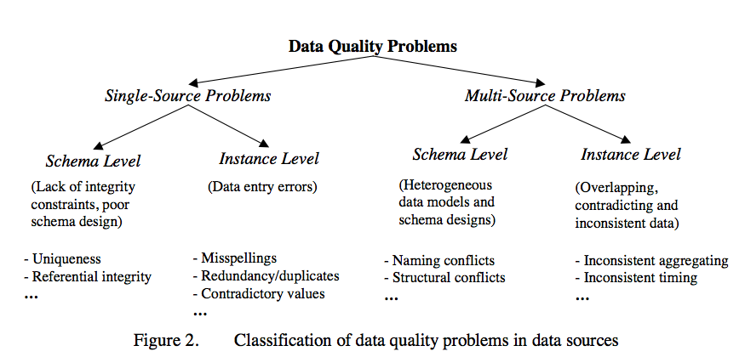
Data quality Problems
Different sources are developed separately, and maintained by different people
Issue 1: Mapping information across sources (schema mapping/transformation)
Naming conflicts: same name used for different objects
Structural conflicts: different representations across sources
We will cover this later
Issue 2: Entity Resolution: Matching entities across sources
Issue 3: Data quality issues
Contradicting information, Mismatched information, etc.
From Data Cleaning: Problems and Current Approaches

Slide 73
Single-source problems
Depends largely on the source
Databases can enforce constraints, whereas data extracted from files or spreadsheets, or scraped from webpages is much more messy
Types of problems:
Ill-formatted data, especially from webpages or files or spreadsheets
Missing or illegal values, Misspellings, Use of wrong fields, Extraction issues (not easy to separate out different fields)
Duplicated records, Contradicting Information, Referential Integrity Violations
Unclear default values (e.g., data entry software needs something)
Evolving schemas or classification schemes (for categorical attributes)
Outliers

Slide 74
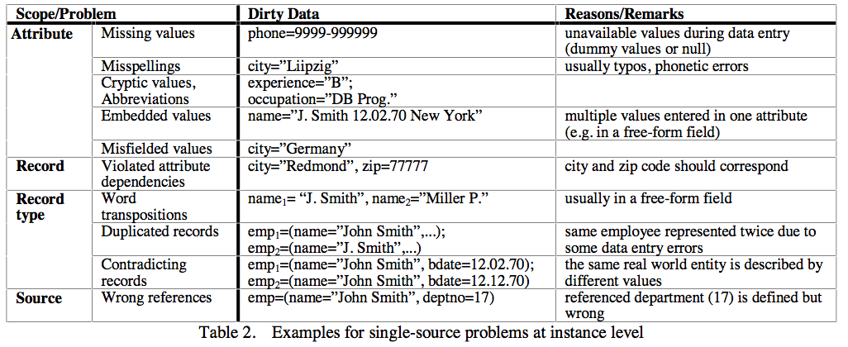
Data quality Problems

Slide 75
Multi-source problems
Different sources are developed separately, and maintained by different people
Issue 1: Mapping information across sources (schema mapping/transformation)
Naming conflicts: same name used for different objects
Structural conflicts: different representations across sources
We will cover this later
Issue 2: Entity Resolution: Matching entities across sources
Issue 3: Data quality issues
Contradicting information, Mismatched information, etc.

Slide 76
Outline
Data Integration
Data Quality Issues
Data Cleaning
Outlier Detection
Constraint-based Cleaning
Entity Resolution

Slide 77
Univariate outliers
A set of values can be characterized by metrics such as center (e.g., mean), dispersion (e.g., standard deviation), and skew
Can be used to identify outliers
Must watch out for "masking": one extreme outlier may alter the metrics sufficiently to mask other outliers
Should use robust statistics: considers effect of corrupted data values on distributions (recall median vs mean, …)
Robust center metrics: median, k% trimmed mean (discard lowest and highest k% values)
Robust dispersion:
Median Absolute Deviation (MAD): median distance of all the values from the median value
A reasonable approach to find outliers: any data points 1.4826x MAD away from median
The above assumes that data follows a normal distribution
May need to eyeball the data (e.g., plot a histogram) to decide if this is true

Slide 78
Univariate outliers
Wikipedia Article on Outliers lists several other normality-based tests for outliers
If data appears to be not normally distributed:
Distance-based methods: look for data points that do not have many neighbors
Density-based methods:
Define density to be average distance to k nearest neighbors
Relative density = density of node/average density of its neighbors
Use relative density to decide if a node is an outlier
Most of these techniques start breaking down as the dimensionality of the data increases
Curse of dimensionality
Can project data into lower-dimensional space and look for outliers there
Not as straightforward

Slide 79
Multivariate outliers
Analogous to above, one set of techniques based on assuming data follows a multi-variate normal distribution
Defined by a mean, μ, and a covariance matrix, Σ
Mahalanobis Depth of a point: Square root of (x - μ)'Σ⁻¹(x - μ)
Measures how far the point x is from the multivariate normal distribution
Look for points that are too far away
Mean/Covariance are not robust -- they are sensitive to outliers
Iterative approach: remove points with high Mahalanobis distance, recompute the mean and covariance
Several other general approaches discussed in the reference above (by Hellerstein)
No clear guidelines here -- need to try different techniques based on the data

Slide 80
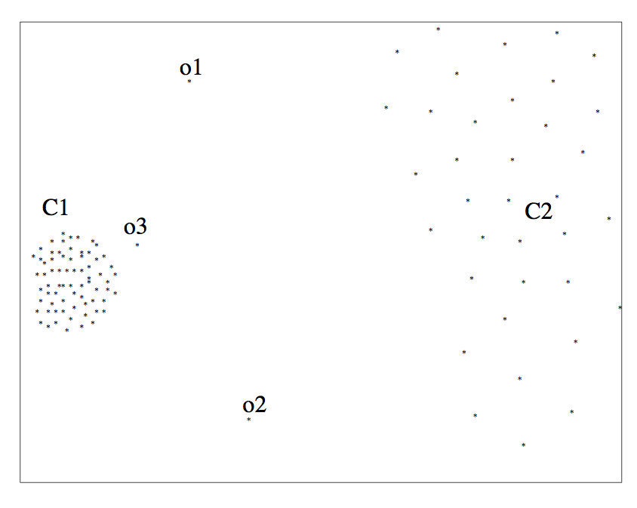
outliers

Slide 81
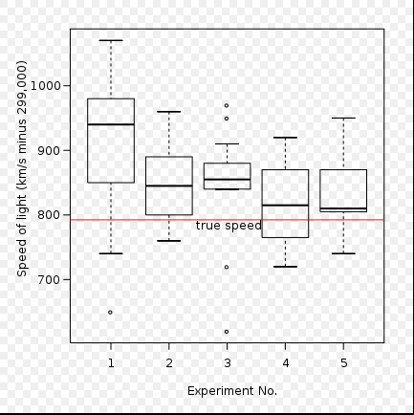
outliers

Slide 82
Other outliers
Timeseries outliers
Often the data is in the form of a timeseries
Can use the historical values/patterns in the data to flag outliers
Rich literature on forecasting in timeseries data
Frequency-based outliers
An item is considered a "heavy hitter" if it is much more frequent than other items
In relational tables, can be found using a simple groupby-count
Often the volume of data may be too much (e.g., internet routers)
Approximation techniques often used
To be discussed sometime later in the class
Things generally not as straightforward with other types of data
Outlier detection continues to be a major research area

Slide 83
Wrap-up
Data wrangling/cleaning are a key component of data science pipeline
Still largely ad hoc although much tooling in recent years
Specifically, we covered:
Schema mapping and matching
Outliers
Next up:
Constraint-based Cleaning
Entity Resolution/Record Linkage/Data Matching

Slide 84
Data Cleaning: Outlier Resolution
From: Entity Resolution Tutorial
Identify different manifestations of the same real world object
Also called: identity reconciliation, record linkage, deduplication, fuzzy matching, Object consolidation, Coreference resolution, and several others
Motivating examples: ?????????????
Postal addresses
Entity recognition in NLP/Information Extraction
Identifying companies in financial records
Comparison shopping
Author disambiguation in citation data
Connecting up accounts on online networks
Crime/Fraud Detection
Census
...

Slide 85
Data Cleaning: Outlier Resolution
Important to correctly identify references
Often actions taken based on extracted data
Cleaning up data by entity resolution can show structure that may not be apparent before
Challenges
Such data is naturally ambiguous (e.g., names, postal addresses)
Abbreviations/data truncation
Data entry errors, Missing values, Data formatting issues complicate the problem
Heterogeneous data from many diverse sources
No magic bullet here !!
Approaches fairly domain-specific
Be prepared to do a fair amount of manual work

Slide 86
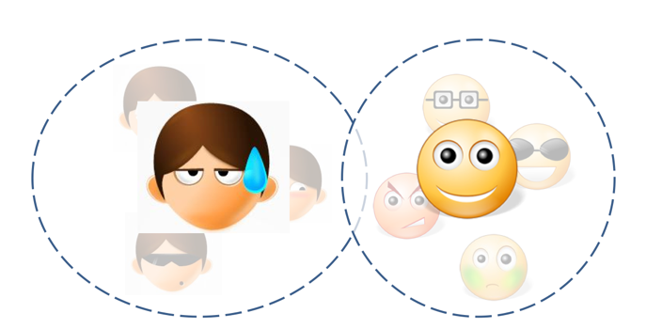
Entity Resolution: Three Slightly Different Problems
Setup:
Real world: there are entities (people, addresses, businesses)
We have a large collection of noisy, ambiguous "references" to those entities (also called "mentions")
Somewhat different techniques, but a lot of similarities
Deduplication
Cluster records/mentions that correspond to the same entity
Choose/construct a cluster representative
This is in itself a non-trivial task (e.g., averaging may work for numerical attributes, but what about string attributes?)

Slide 87
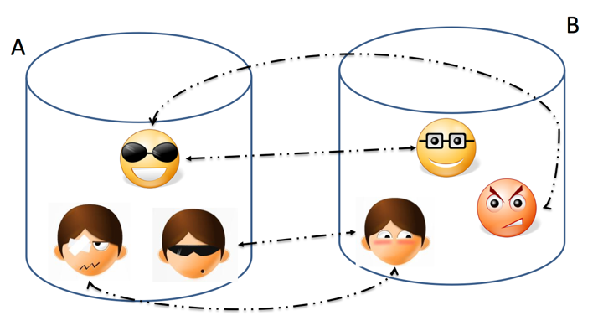
Entity Resolution: Three Slightly Different Problems
Setup:
Real world: there are entities (people, addresses, businesses)
We have a large collection of noisy, ambiguous "references" to those entities (also called "mentions")
Somewhat different techniques, but a lot of similarities
Record Linkage
Match records across two different databases (e.g., two social networks, or financial records w/ campaign donations)
Typically assume that the two databases are fairly clean

Slide 88
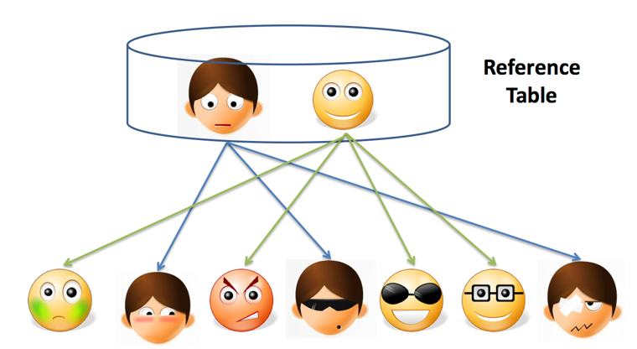
Entity Resolution: Three Slightly Different Problems
Setup:
Real world: there are entities (people, addresses, businesses)
We have a large collection of noisy, ambiguous "references" to those entities (also called "mentions")
Somewhat different techniques, but a lot of similarities
Reference Matching
Match "references" to clean records in a reference table
Commonly comes up in "entity recognition" (e.g., matching newspaper article mentions to names of people)

Slide 89
Entity Resolution: Data Matching
Comprehensive treatment: Data Matching; P. Christen; 2012 (Springer Books -- not available for free)
One of the key issues is finding similarities between two references
What similarity function to use?
Edit Distance Functions
Levenstein: min number of changes to go from one reference to another
A change is defined to be: a single character insertion or deletion or substitution
May add transposition
Many adjustments to the basic idea proposed (e.g., higher weights to changes at the start)
Not cheap to compute, especially for millions of pairs
Set Similarity
Some function of intersection size and union size
E.g., Jaccard distance = size of intersection/size of union
Much faster to compute
Vector Similarity
Cosine similarity – we’ll talk about this much more in NLP lectures

Slide 90
Entity Resolution: Data Matching
Q-Grams
Find all length-q substrings in each string
Use set/vector similarity on the resulting set
Several approaches that combine the above (especially q-grams and edit distance, e.g., Jaro-Winkler)
Soundex: Phonetic Similarity Metric
Homophones should be encoded to the same representation so spelling errors can be handled
Robert and Rupert get assigned the same code (R163), but Rubin yields R150
May need to use Translation Tables
To handle abbreviations, nicknames, other synonyms
Different types of data requires more domain-specific functions
E.g., geographical locations, postal addresses
Also much work on computing distances between XML documents etc.

Slide 91
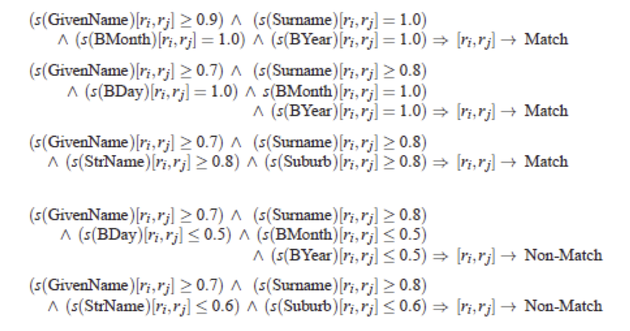
Entity Resolution: Algorithms
Simple threshold method
If the distance below some number, the two references are assumed to be equal
May review borderline matches manually
Can be generalized to rule-based:
Example from Christen, 2012

Slide 92
Entity Resolution: Algorithms
May want to give more weight to matches involving rarer words
More naturally applicable to record linkage problem
If two records match on a rare name like "Machanavajjhala", they are likely to be a match
Can formalize this as "probabilistic record linkage”
Constraints: May need to be satisfied, but can also be used to find matches
Often have constraints on the matching possibilities
Transitivity: M1 and M2 match, and M2 and M3 match, and M1 and M3 must match
Exclusivity: M1 and M2 match --> M3 cannot match with M2
Other types of constraints:
E.g., if two papers match, their venues must match

Slide 93
Entity Resolution: Algorithms
Clustering-based ER Techniques:
Deduplication is basically a clustering problem
Can use clustering algorithms for this purpose
But most clusters are very small (in fact of size = 1)
Some clustering algorithms are better suited for this, especially Agglomerative Clustering
Unlikely K-Means would work here

Slide 94
Entity Resolution: Algorithms
Crowdsourcing
Humans are often better at this task
Can use one of the crowdsourcing mechanisms (e.g., Mechanical Turk) for getting human input on the difficult pairs
Quite heavily used commercially (e.g., to disambiguate products, restaurants, etc.)

Slide 95
Entity Resolution: Scaling to Big Data
One immediate problem
There are O(N²) possible matches
Must reduce the search space
Use some easy-to-evaluate criterion to restrict the pairs considered further
May lead to false negative (i.e., missed matches) depending on how noisy the data is
Much work on this problem as well, but domain-specific knowledge likely to be more useful in practice
One useful technique to know: min-hash signatures
Can quickly find potentially overlapping sets
Turns up to be very useful in many domains (beyond ER)

